Slide 1
Leading Causes of Death in the United States
Center for Disease Control (CDC) – National Center for Health Statistics (NCHS)
Group 4
Roman Grinevich
Yohan Khan
Daria Kosovsky
Raymond Willey

Slide 2
Questions Related to Public Health
What is the leading cause of death in the United States?
What is the current trend for the leading cause of death?
Which factors have the greatest impact?
How effectively can we predict where these rates will be in the future?

Slide 3
Data Sources
Leading Causes of Death
National Center for Health Statistics
State Populations & Demographics
Centers for Disease Control & Prevention
State Size
(Land Area)
State Symbols USA
Alcohol Consumption
National Institute on Alcohol Abuse and Alcoholism
Smoking
United Health Foundation
Notes:
Includes the number of deaths by state from 1999-2016
Includes population data broken down by age group, gender, state, and year from 1999-2017.
Death rate calculated as percentage of total population, not percentage of total deaths.
State size – Self Explanatory
Alcohol consumption measured as average amount of alcohol consumed per capita annually by beverage type (wine, beer, spirits). Broken down by year and state based on alcohol sales and percentage of population 14 years or older.
Smoking numbers represent percentage of population that reported smoking at least 100 cigarettes in their lifetime.

Slide 4
Data Sources
Smoking
United Health Foundation
Notes:
Methodology for calculating smoking population changed in 2012. To account for this change, we used the prior 5 years to estimate an adjustment for 2012 and scale values down…

Slide 5
Data Sources
Smoking
United Health Foundation
Notes:
…see results here.

Slide 6
Top 10 Causes of Death
Notes:
Heart disease is leading cause of death. Need to determine if difference with cancer is statistically significant.

Slide 7
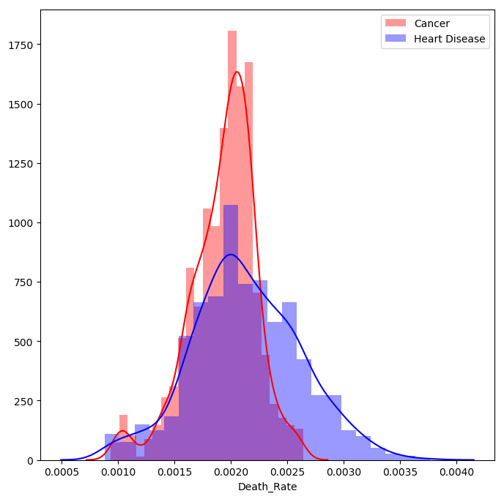
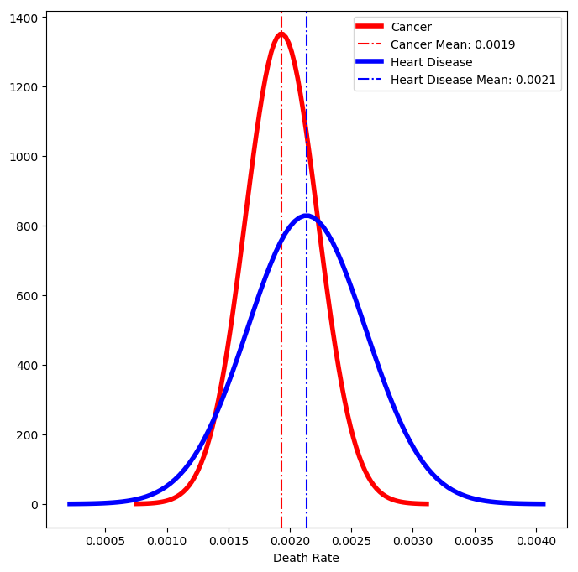
Cancer vs Heart Disease
P-Value: 6.71e-27
Heart Disease Mean: 0.002135 Std Dev: 0.000481 | Cancer Mean: 0.001932 Std Dev: 0.000295
Notes:
Red: Cancer
Blue: Heart Disease
Cancer Mean: 0.001932
Heart Disease Mean: 0.002135
Percent Mean Difference: 10.53%
Cancer Std Dev: 0.000295
Heart Disease Std Dev: 0.000481
Percent Std Dev Difference: 63.02%

Slide 8
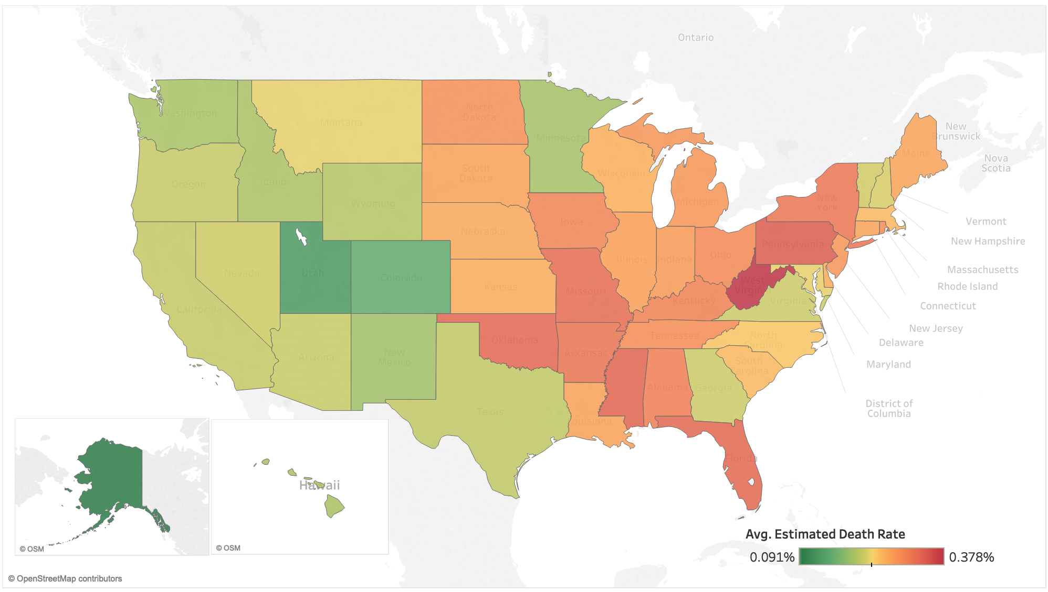
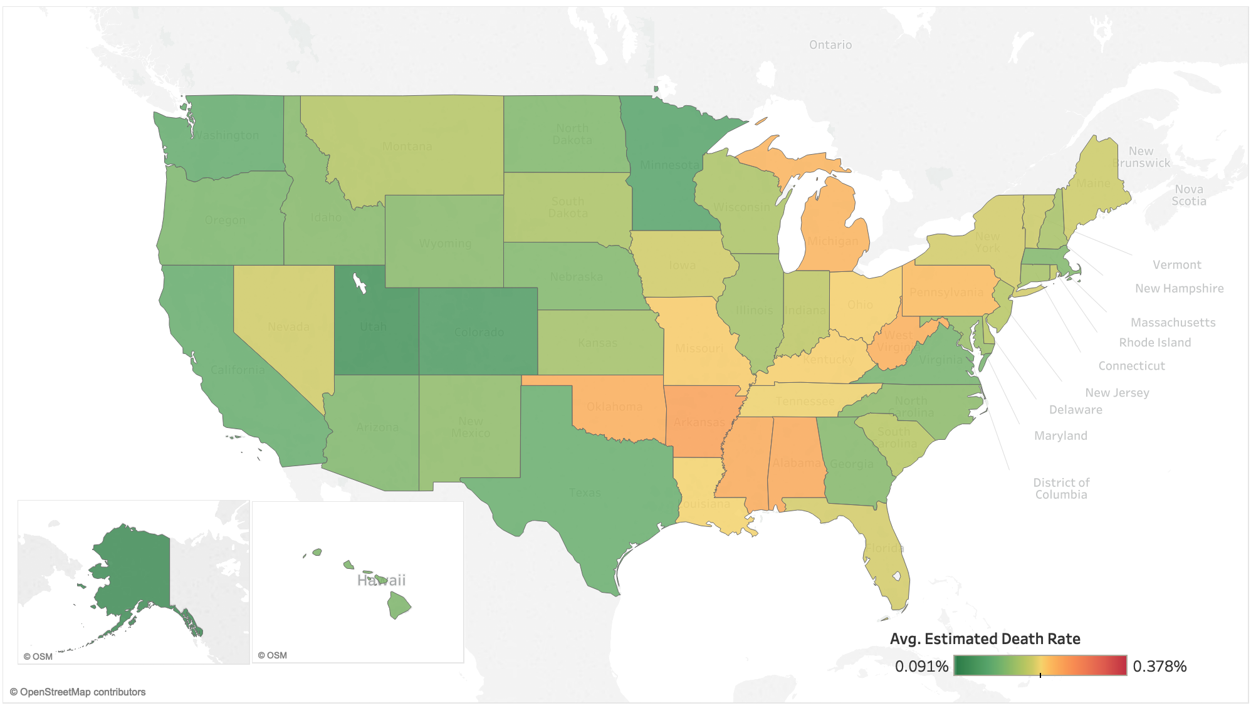
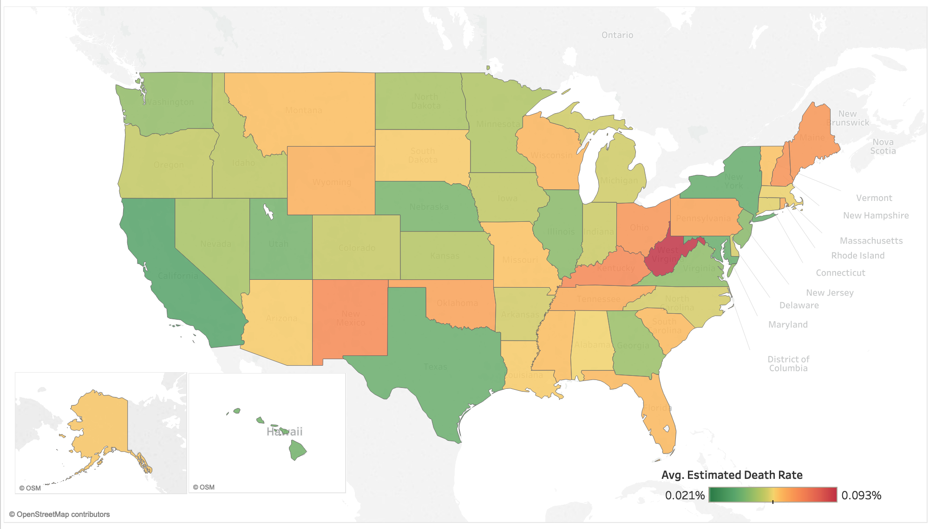
Has the rate of death from heart disease increased or decreased between 1999 and 2016?

Slide 9
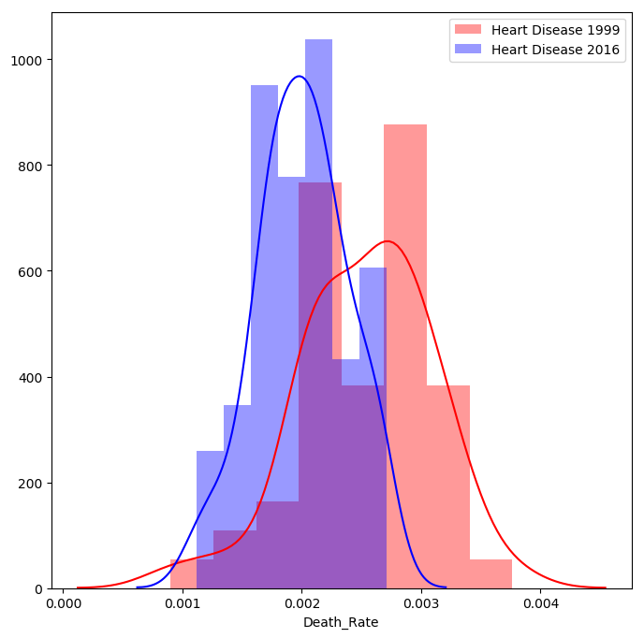
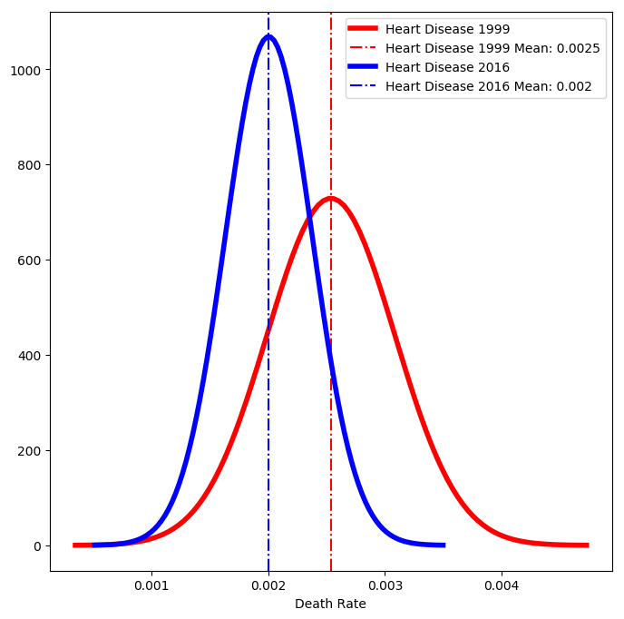
Is the death rate due to heart disease significantly lower in 2016 than 1999?
Null Hypothesis: Difference in death rates is greater than or equal to 0.
Alternative Hypothesis: Difference is less than 0.
Notes:
Key Metrics for Heart Disease 2016 Heart Disease
1999 Mean: 0.002537
Heart Disease 2016 Mean: 0.002005
Percent Mean Difference: -20.98%
Heart Disease 1999 Std Dev: 0.000547
Heart Disease 2016 Std Dev: 0.000373
Percent Std Dev Difference: -31.79% Test Statistic: -5.682 P-Value: 1.31574e-07 (Crazy small)

Slide 10
Factors Impacting Heart Disease
Population
Density
Gender
Age Group
Alcohol Consumption
Beer
Wine
Spirits
Smoking Habits
% Population Smoked >= 100 Cigarettes in Lifetime
Diabetes Rates
Diabetes Deaths used as Proxy
Notes:
So now we want to look at the factors that most impact the rate of death due to heart disease. We looked at population demographics, including age and gender, alcohol consumption, smoking habits, and the diabetes rates.
Our goal is to see if we can use these factors to predict which states are at high risk for heart disease.

Slide 11
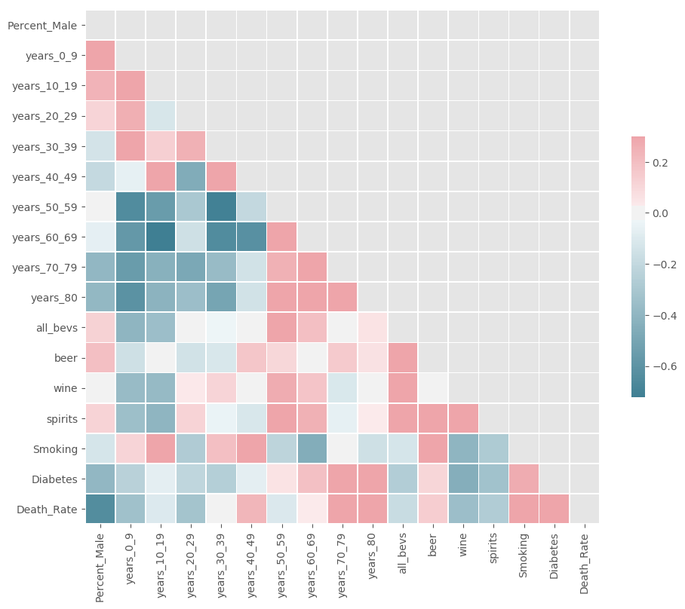
Collinearity Check
Notes:
Before we could perform any regression or classification analyses, we had to check for collinearity. In this correlation heat map, dark red represents high positive correlation, while dark blue represents high negative correlation.
High collinearity with our target variable is good, but high collinearity among independent variables is bad. Here, we see a large dark blue section which highlights negative collinearity among age groups. This make sense because if a higher percentage of the population is young, a lower percentage will be old. Given the objective, we felt it made sense to drop the lower age groups.

Slide 12
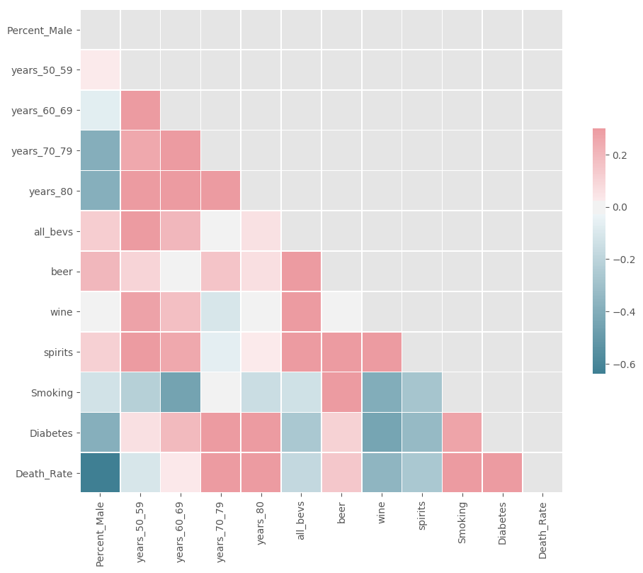
Collinearity Check
Notes:
Having dropped these variables, we can see we have eliminated many of those dark spots, so we can move on with performing regression analysis.

Slide 13
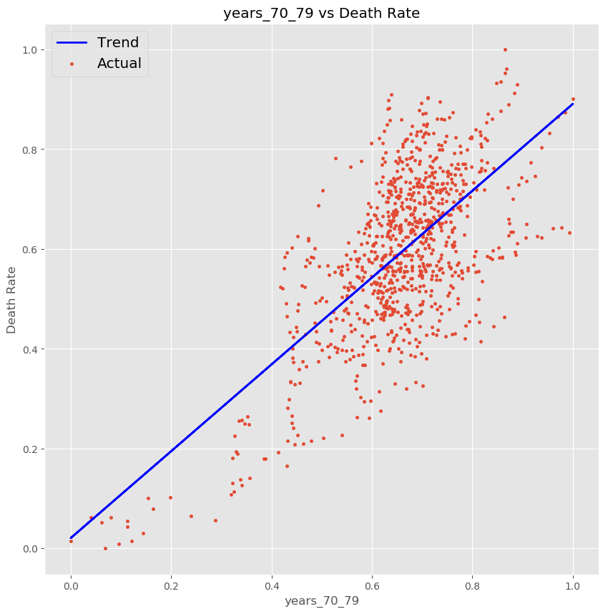
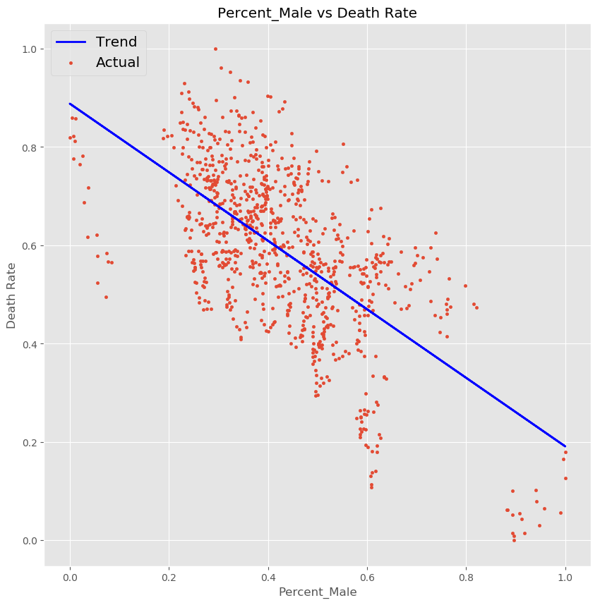
Strongest Demographic Predictors
Notes:
Here, we have a few simply linear regressions highlighting variables that have a strong relationship with heart rate death rates.
Higher percentages of the population in the 70-79 age group are indicative of high death rates, while higher percentages of male population show a decreased risk of heart disease deaths.

Slide 14
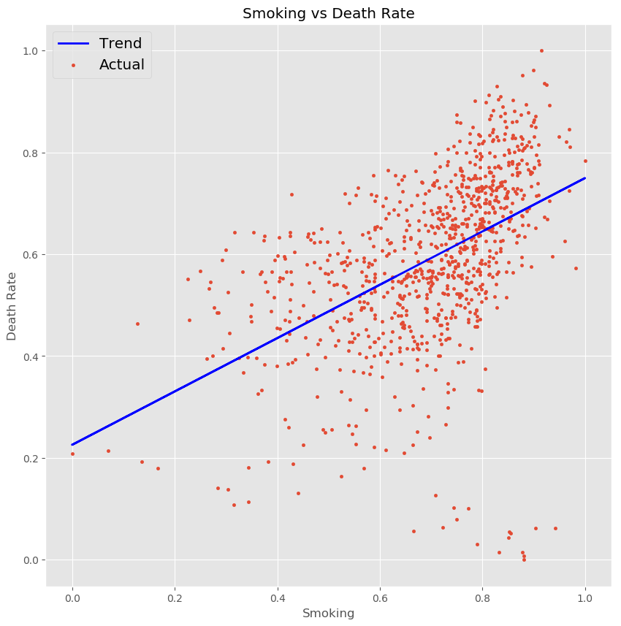
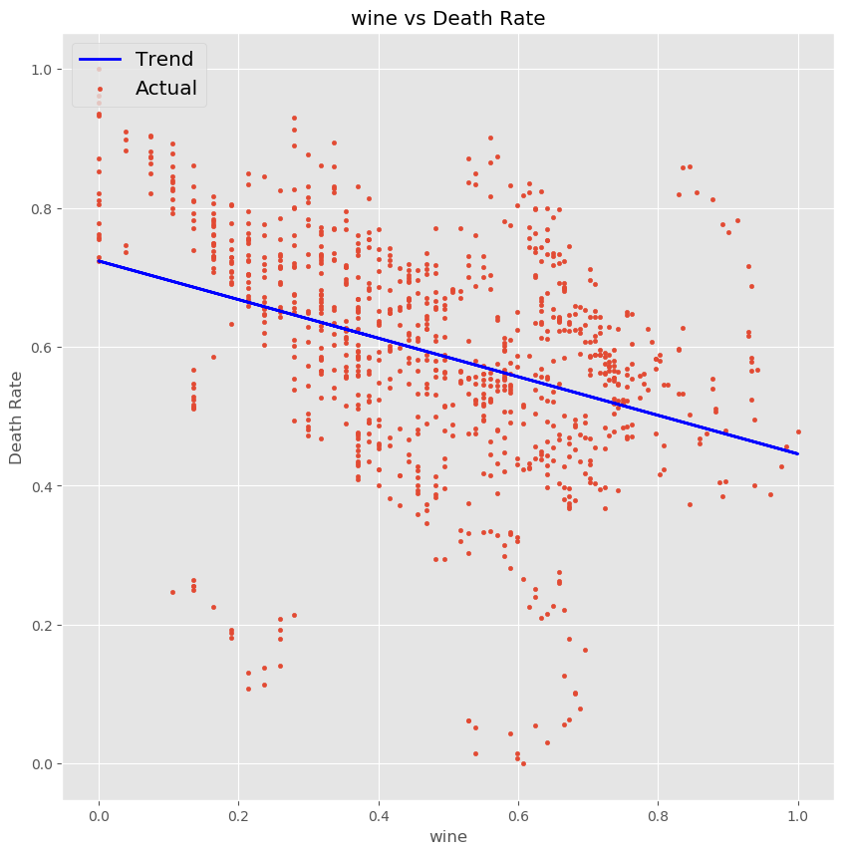
Strongest Behavioral Predictors
Notes:
As far as behavioral predictors are concerned, smoking is highly correlated with heart disease, while alcohol consumption actually shows a slightly negative correlation.
However, when we put these all together into a single model, not all of these relationships held.

Slide 15
Best Multiple Linear Regression Model
 | Coefficient | P-Value
Percent Male | -0.393 | 0.000
Age Group: 50-59 | -0.161 | 0.000
Age Group: 70-79 | 0.571 | 0.000
Age Group: 80+ | 0.149 | 0.000
All Drinks | 0.897 | 0.000
- Beer | -0.386 | 0.000
- Wine | -0.368 | 0.000
- Spirits | -0.320 | 0.000
Smoking | 0.409 | 0.000
R-Square Value: 0.848
Notes:
Interestingly, while consumption of any single type of alcohol is negatively correlated with heart disease, consumption of all types of alcohol has the strongest impact. Smoking and age are also, not surprisingly, strong contributors.
Now that we have our predictors, we can break our data into train and test sets to test the performance. Rather than doing a random split, we split the data at 2015 to see if we could use past data to predict 2016 data.

Slide 16
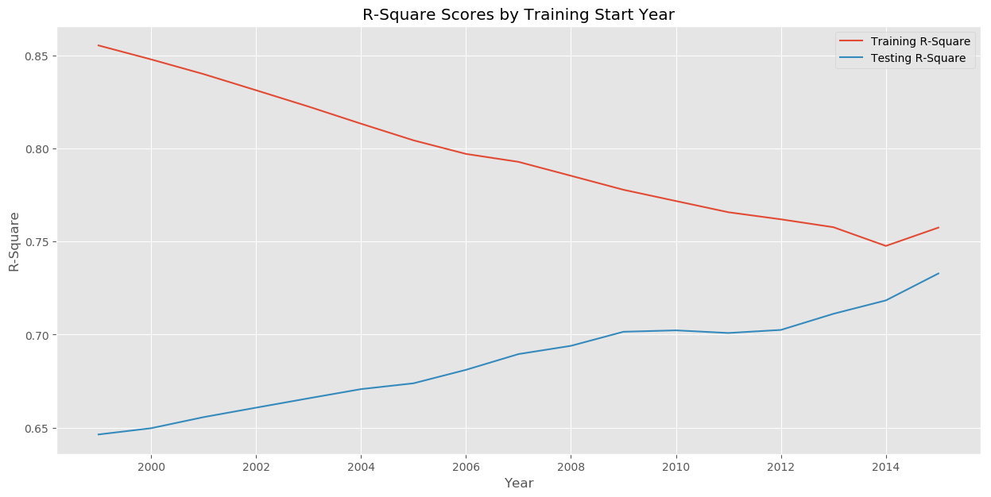
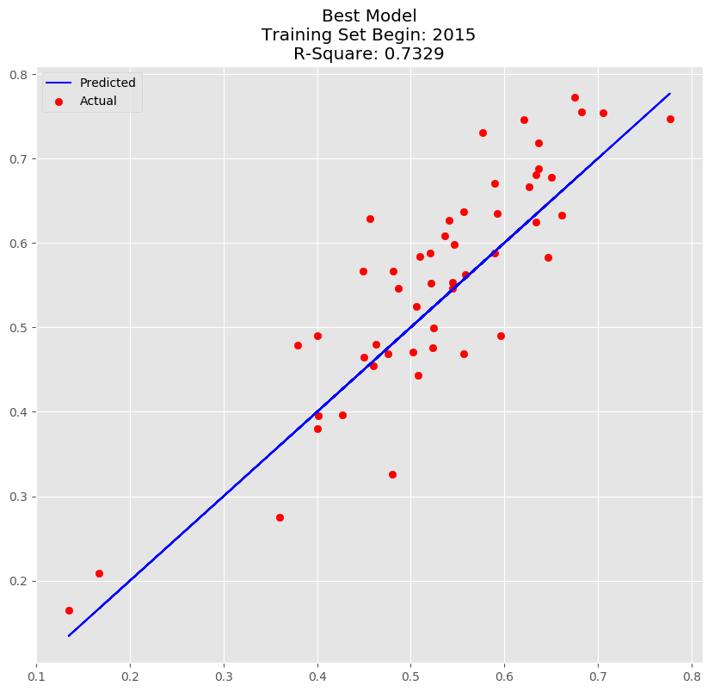
Are all years relevant when attempting to make predictions?
Notes:
Now

Slide 17
Predict High Risk States with Decision Tree Classifier
Criterion Used: Information Gain
Max Depth Levels: 1 – 10
Minimum Samples Split: 5% - 95% (10% intervals)
Minimum Leave Sizes: 1 – 10
Maximum Features: 1 – 10
Model Target: Maximize F-Score
Training Years: 1999 – 2015
Total Combinations: 160,000

Slide 18
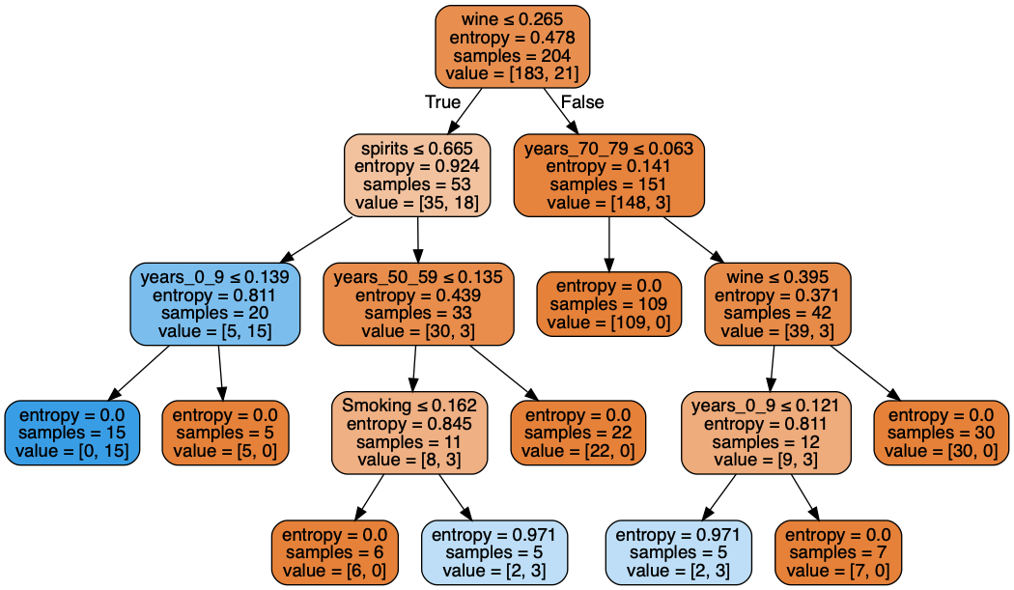
Best Model
Predicted Actual | False | True | All
False | 44 | 0 | 44
True | 0 | 7 | 7
All | 44 | 7 | 51
F-Score: 100%
Notes:
Moderate consumption of wine and spirits may improve heart health. But it could be that drinking wine and spirits are correlated with healthier lifestyles. Wine consumption is negatively correlated with smoking.

Slide 19
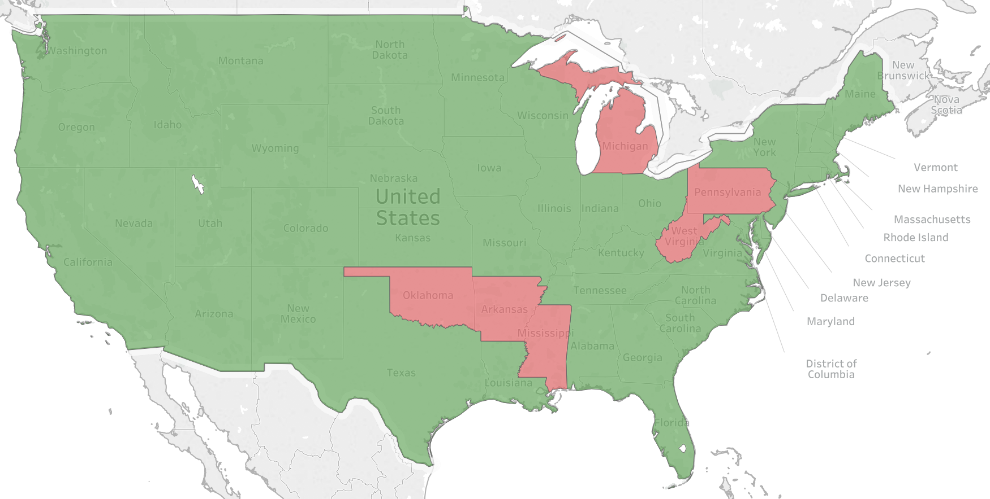
2016 High Risk States
Arkansas
Michigan
Mississippi
Oklahoma
Pennsylvania
West Virginia

Slide 20
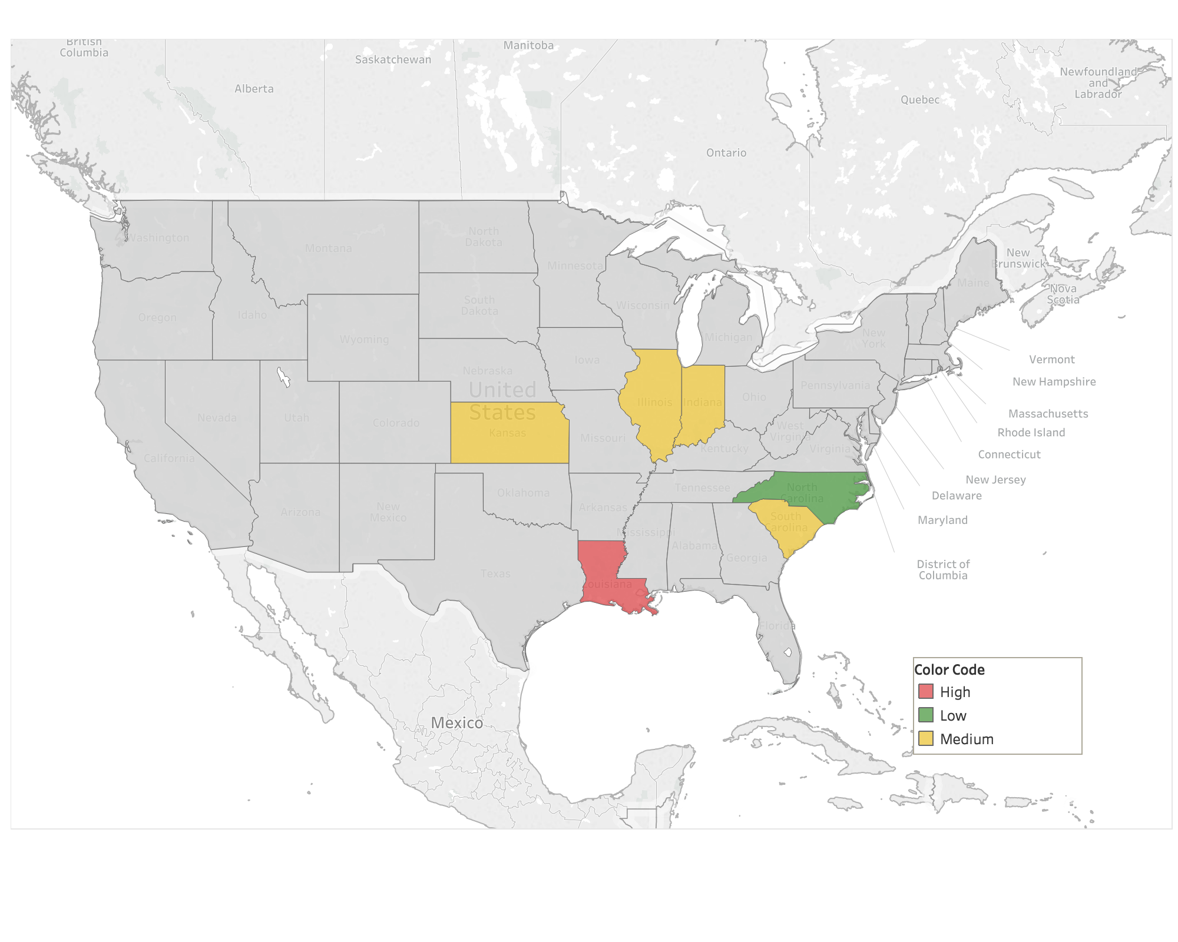
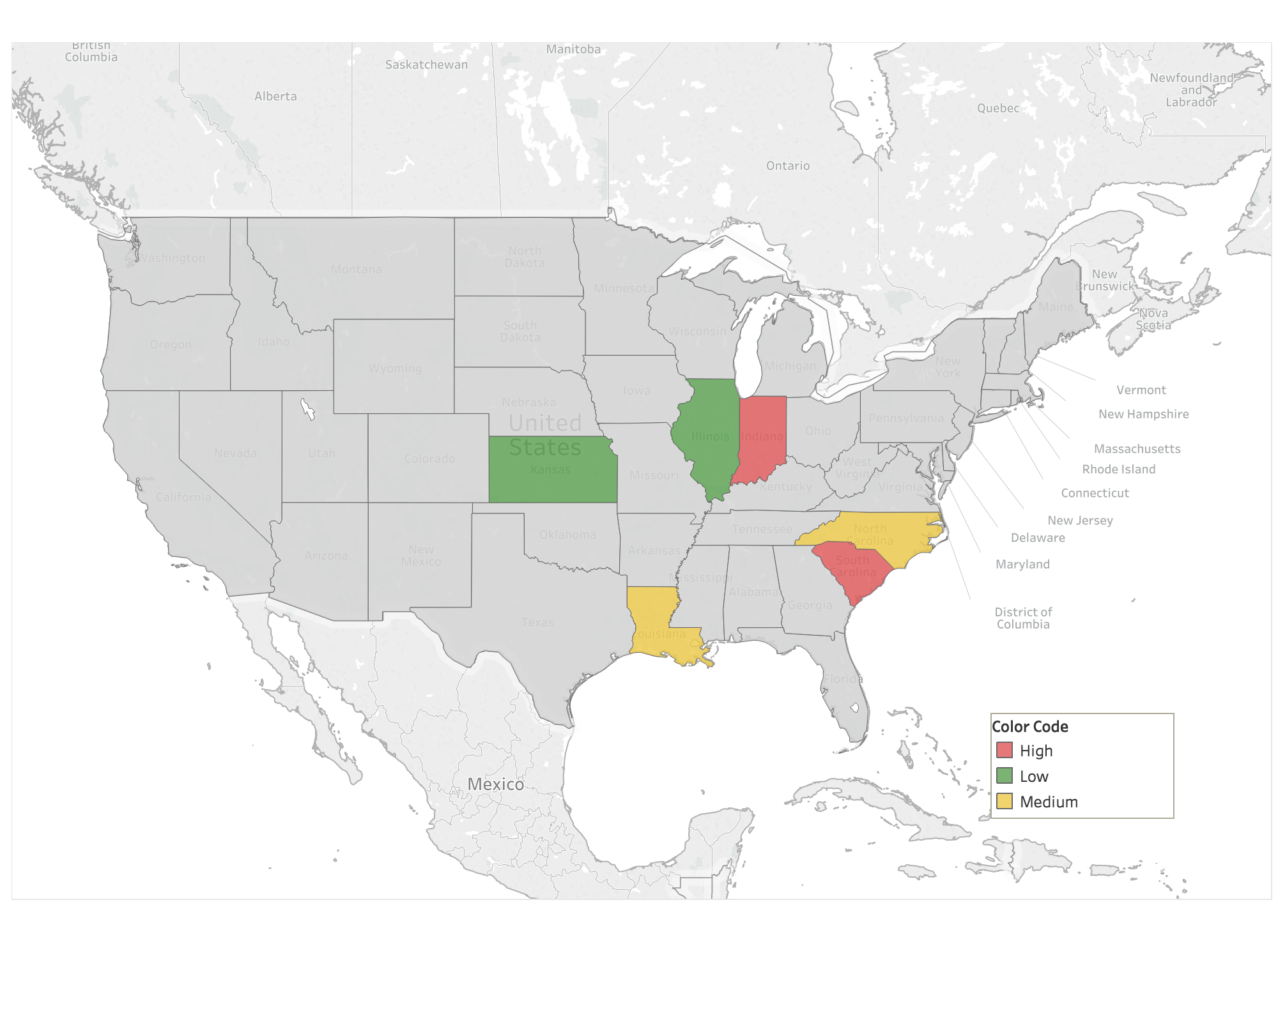
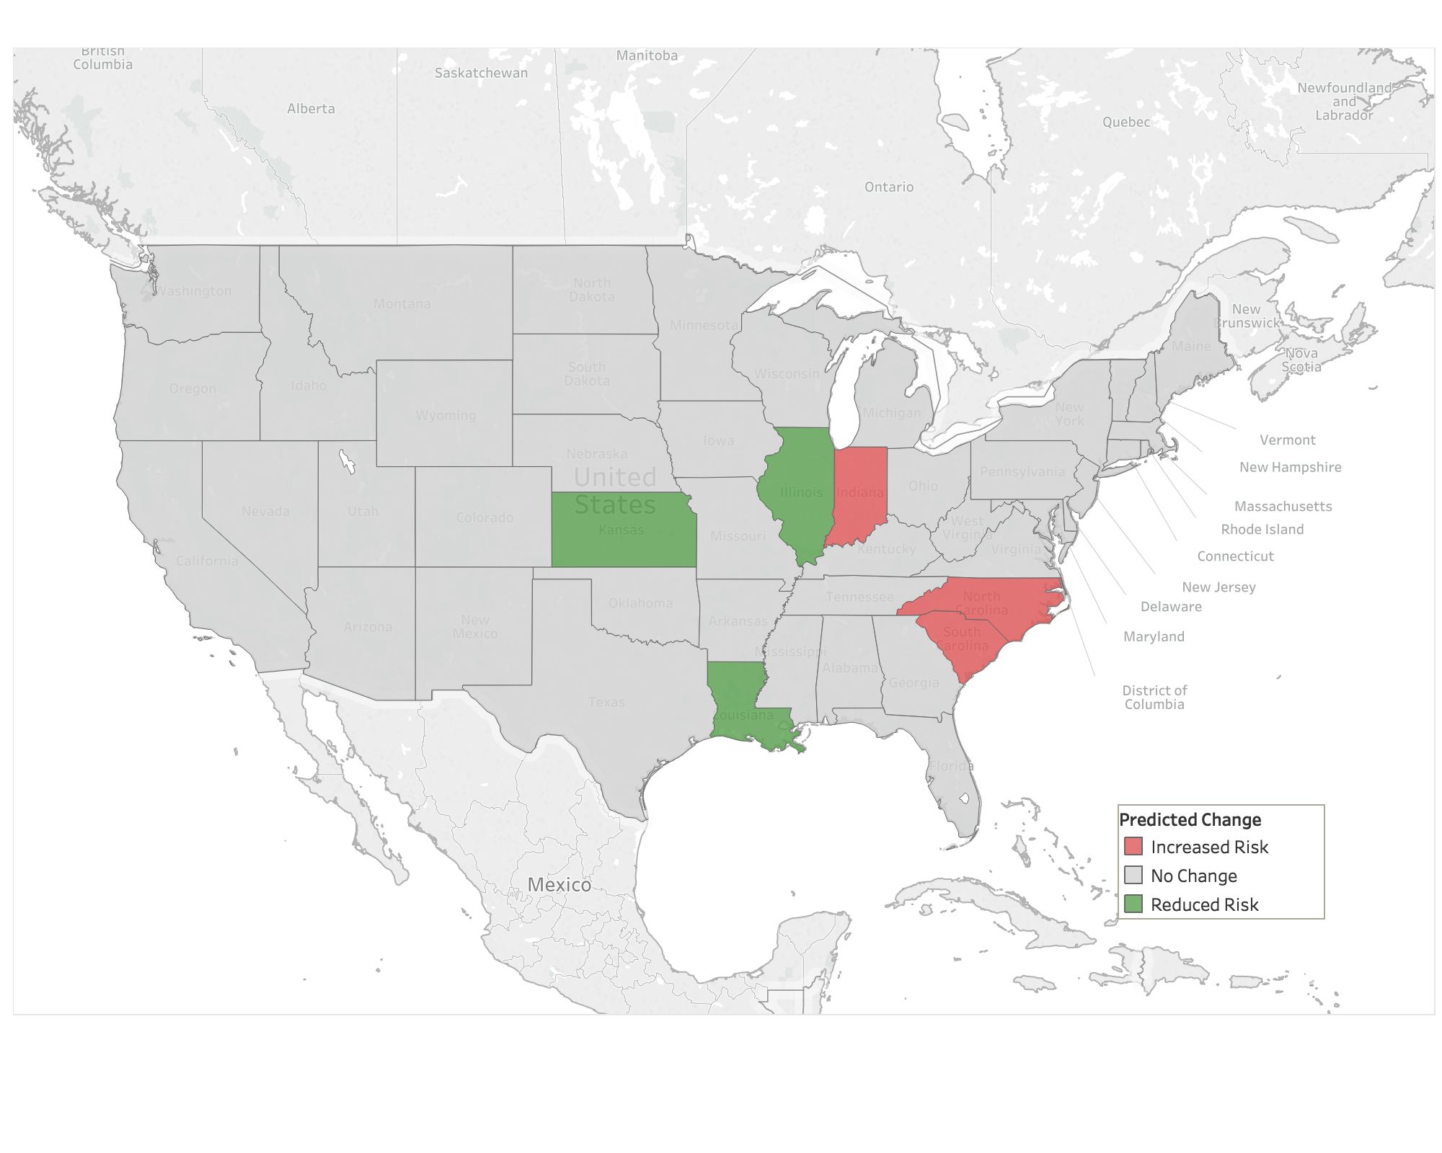
2019 Predictions
2016 Results
Indiana – Increased Risk
Illinois – Reduced Risk
Kansas – Reduced Risk
Louisiana – Reduced Risk
N. Carolina – Increased Risk
S. Carolina – Increased Risk
Indiana
Illinois
Kansas
Louisiana
N. Carolina
S. Carolina

